Slide 1

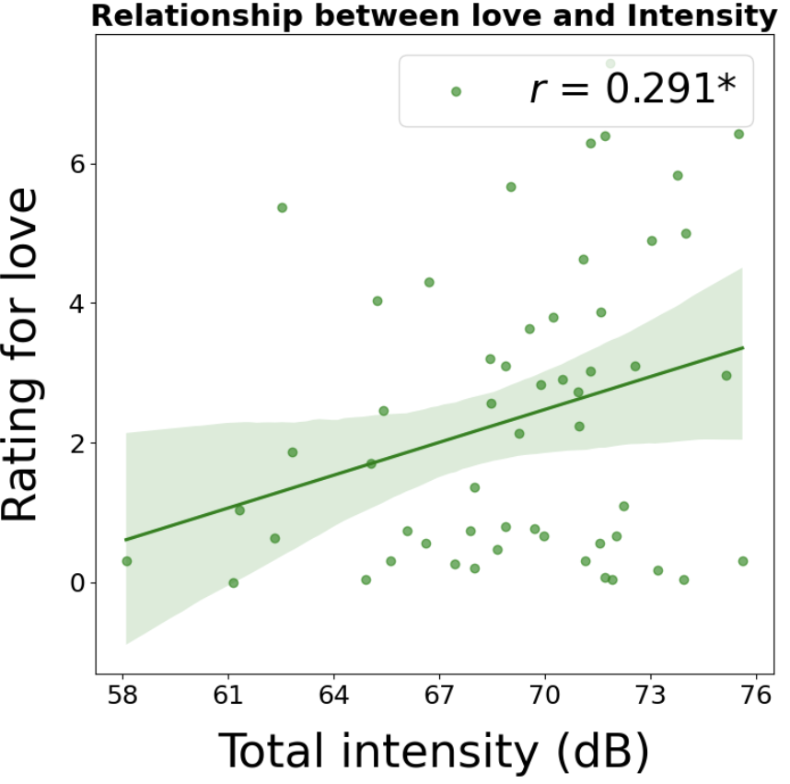
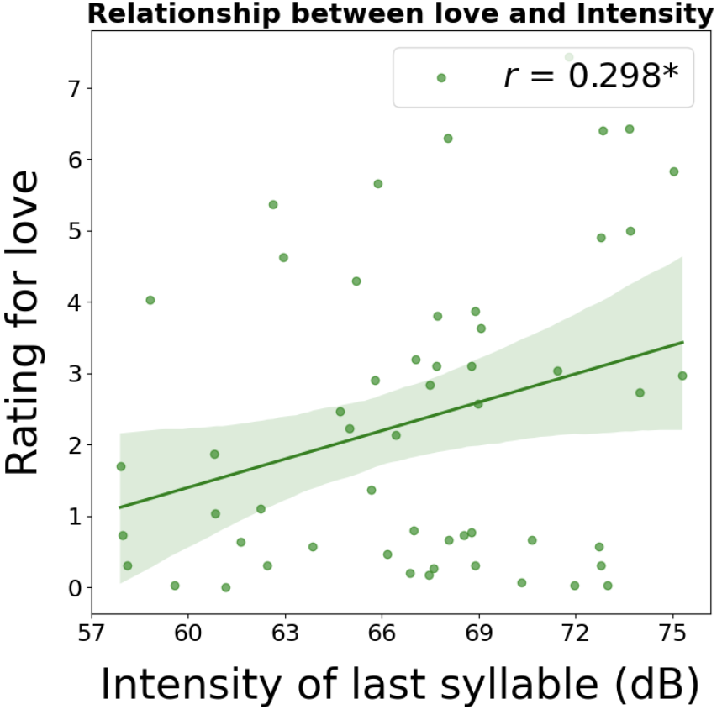
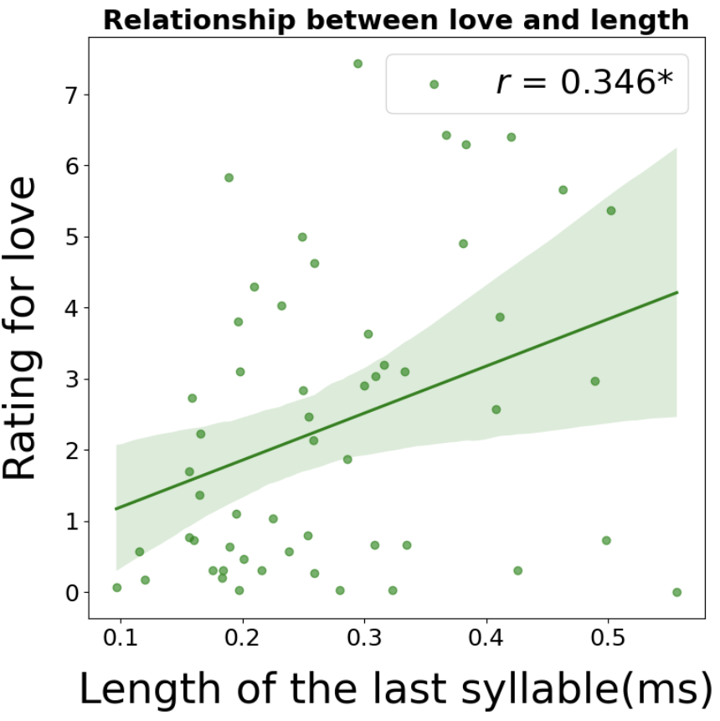
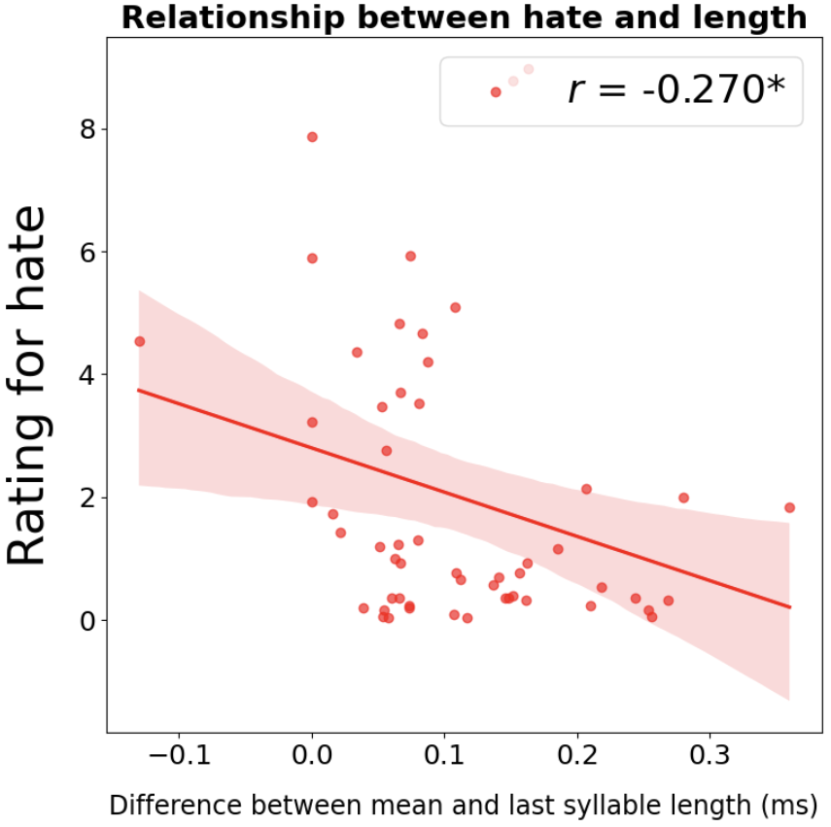
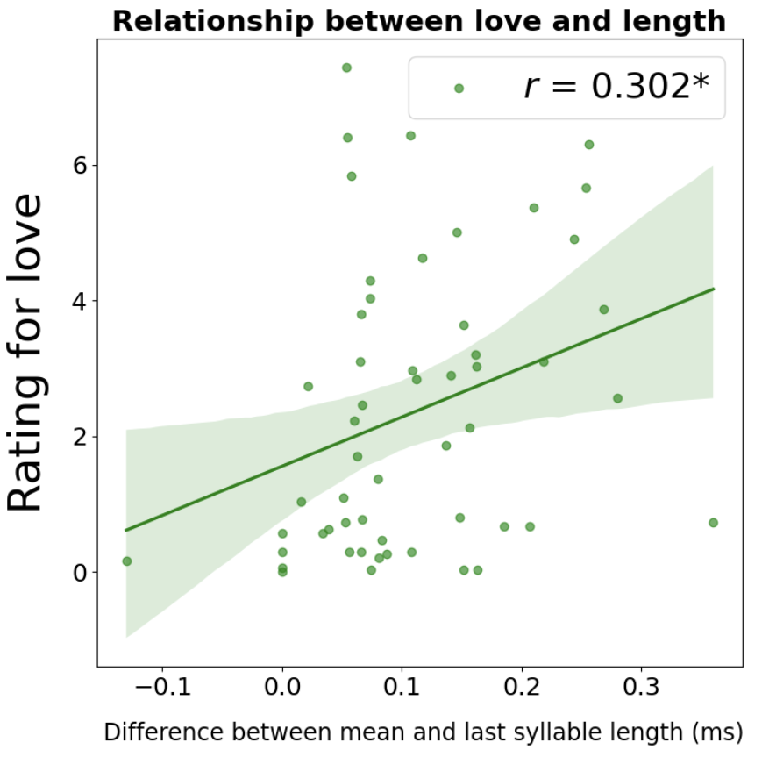
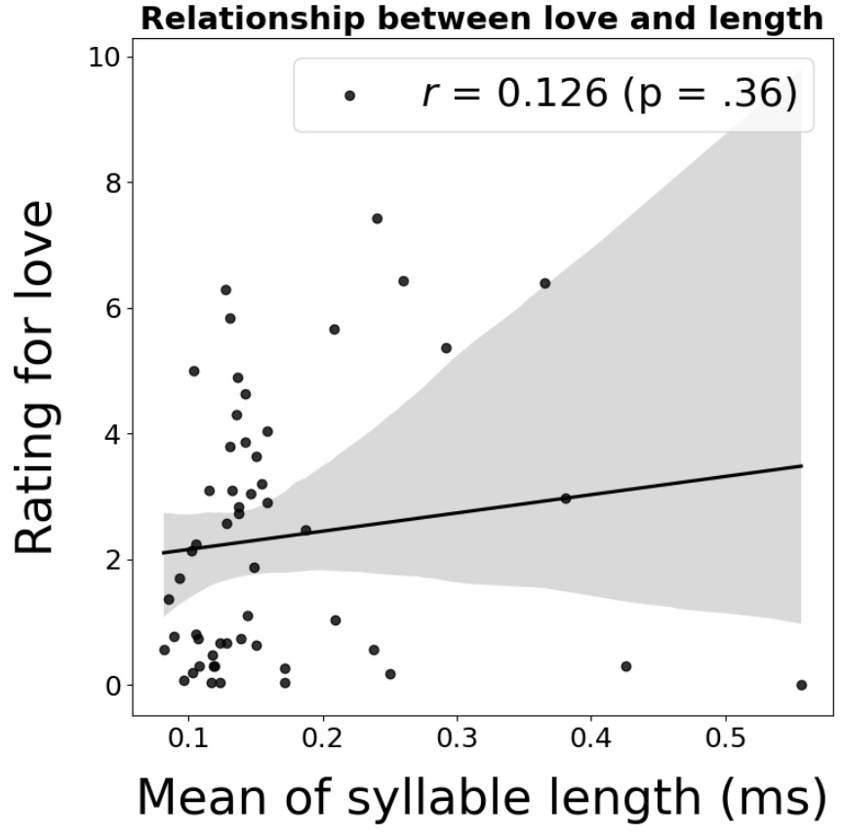
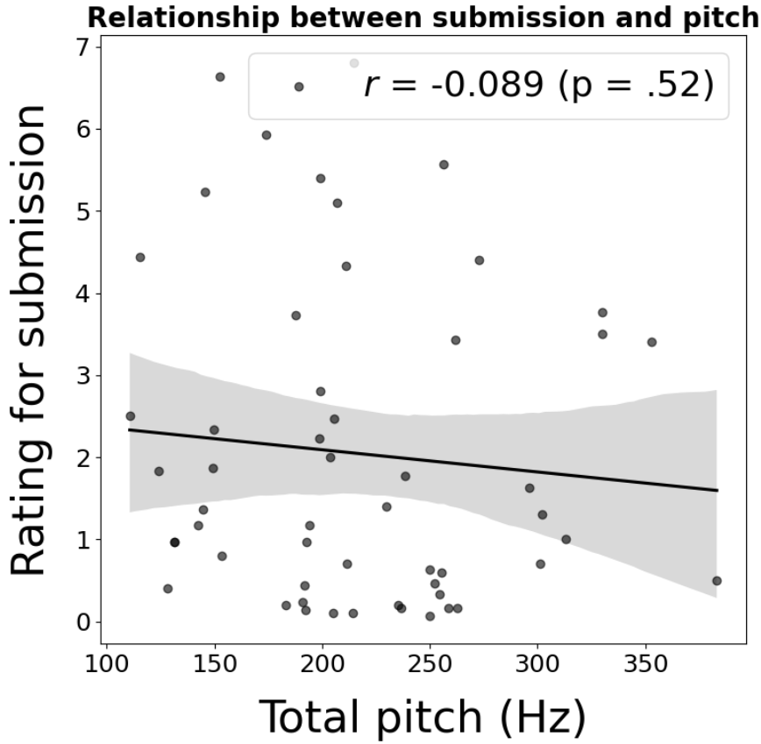
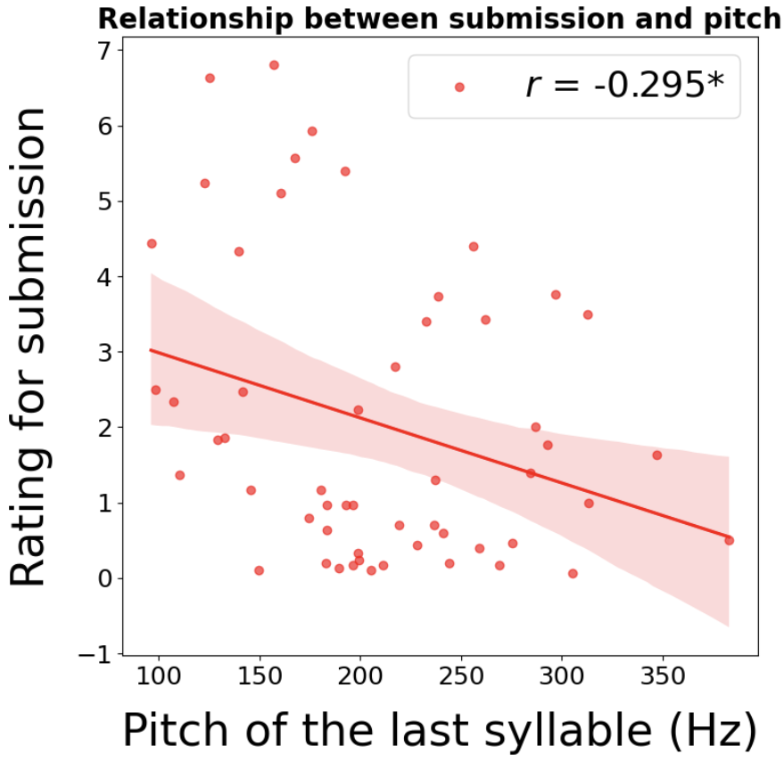
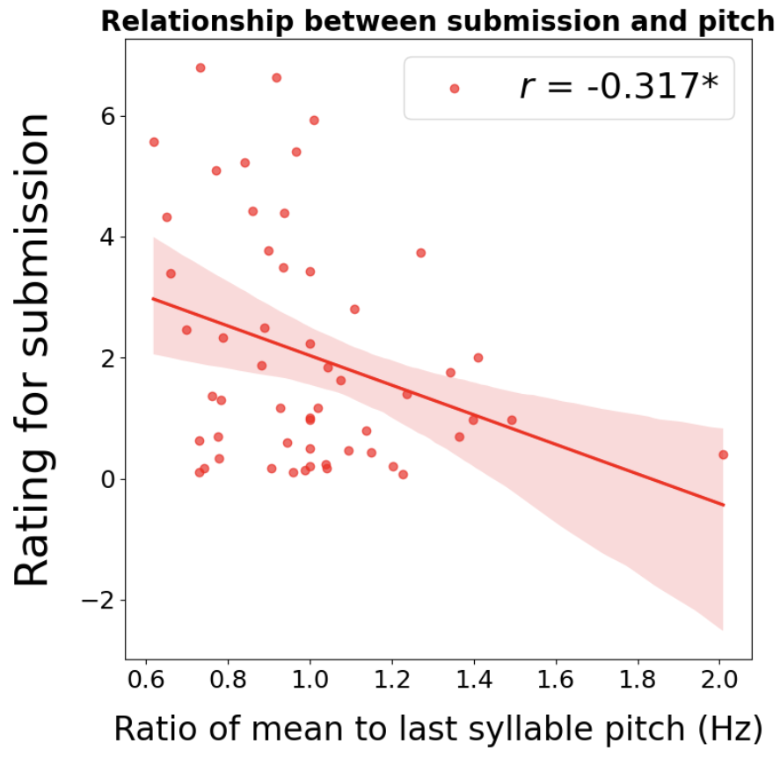



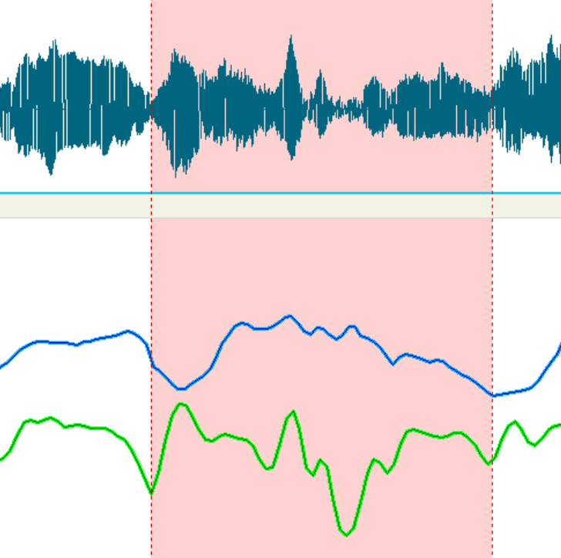

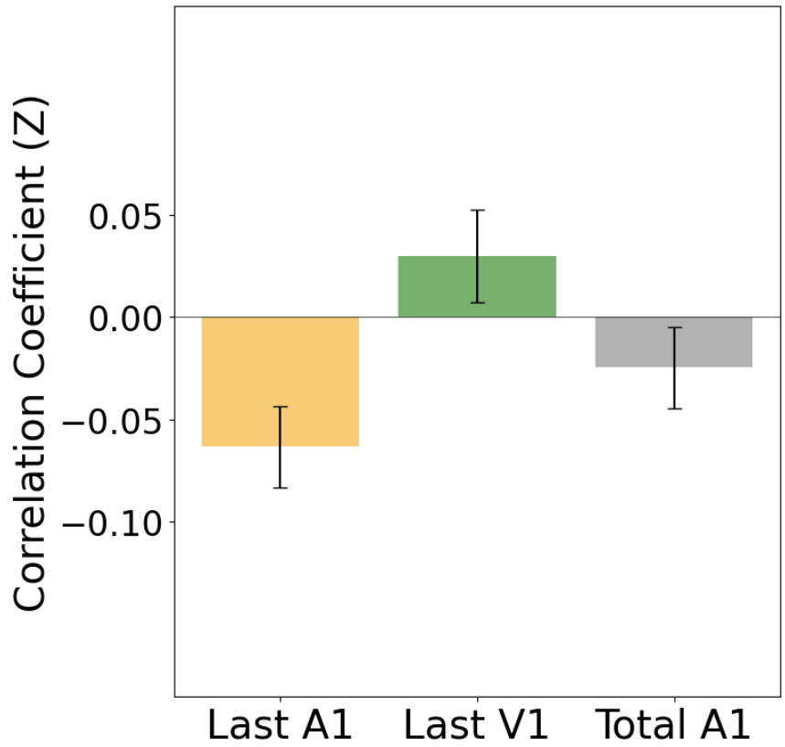

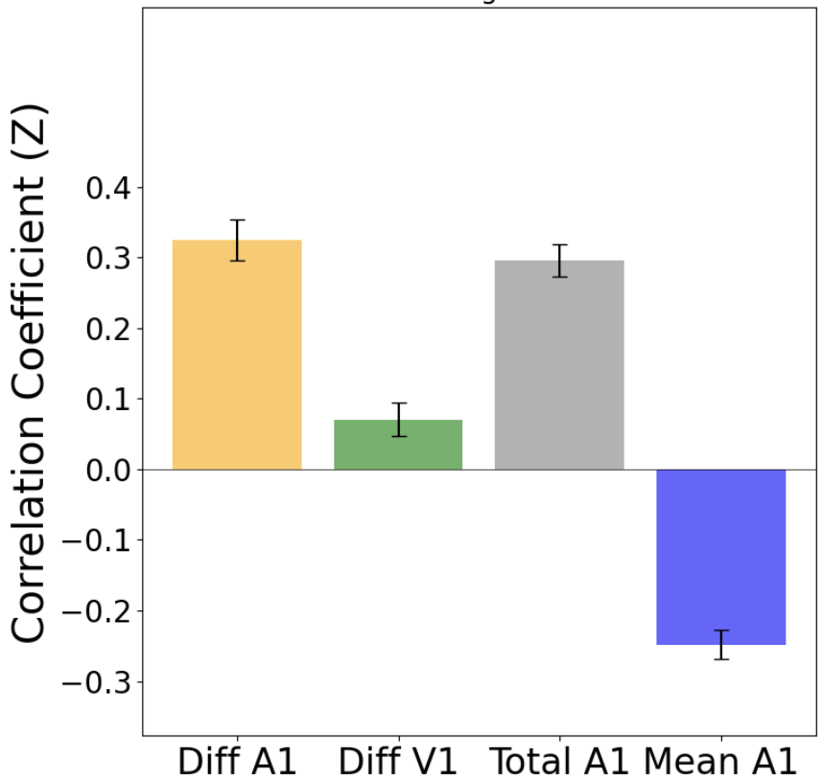
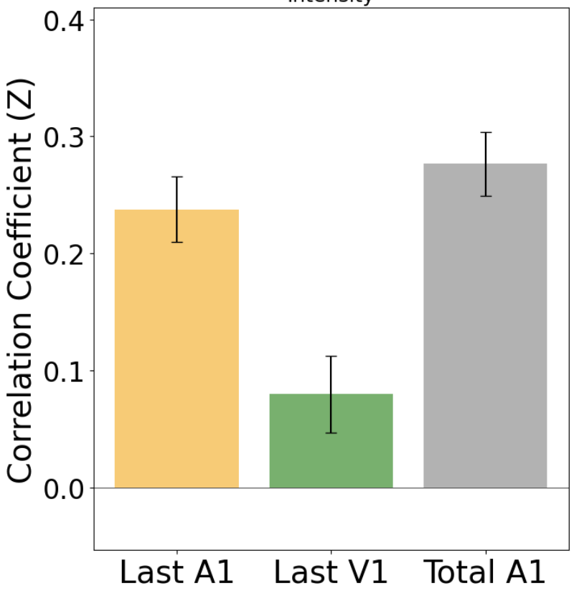

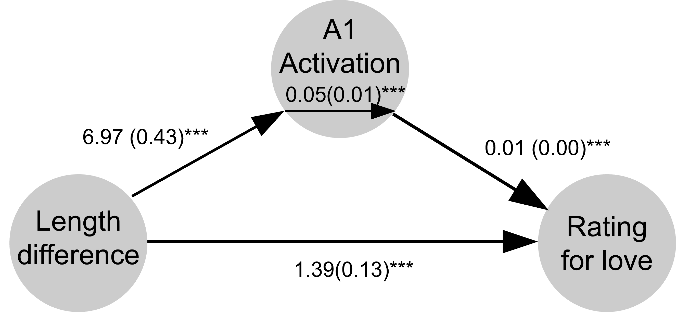
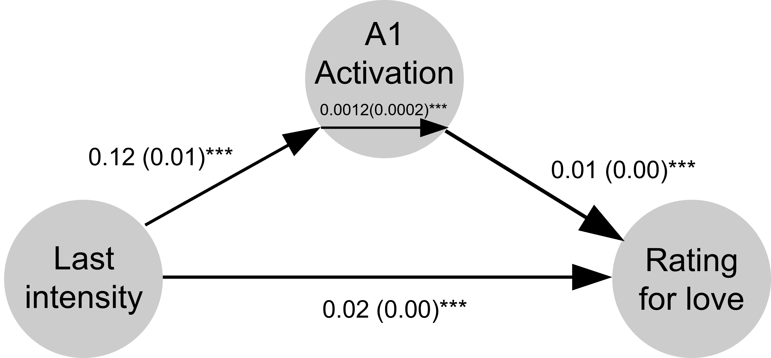
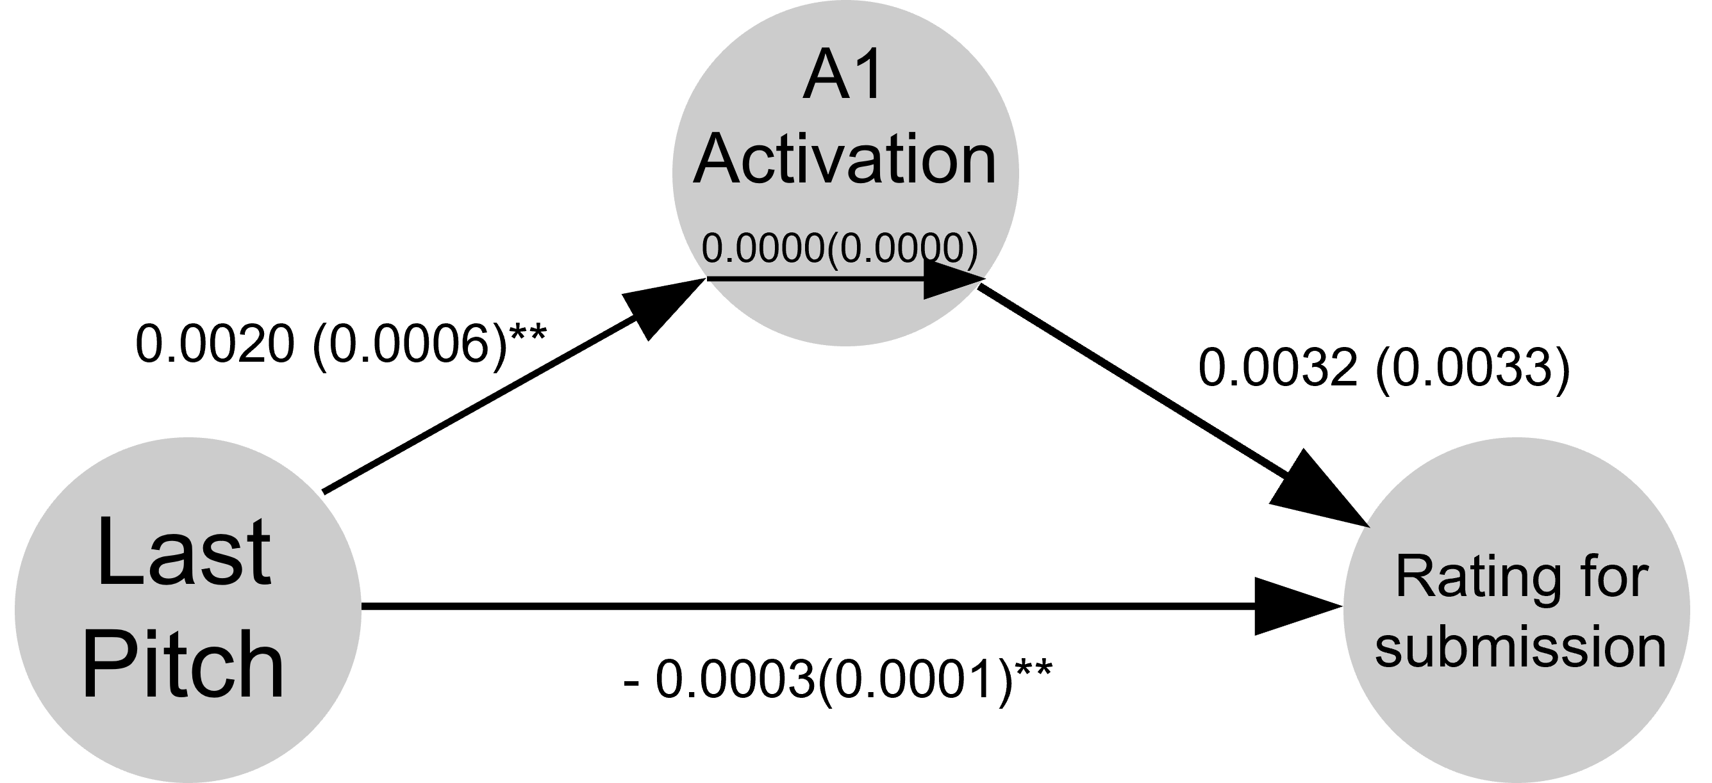
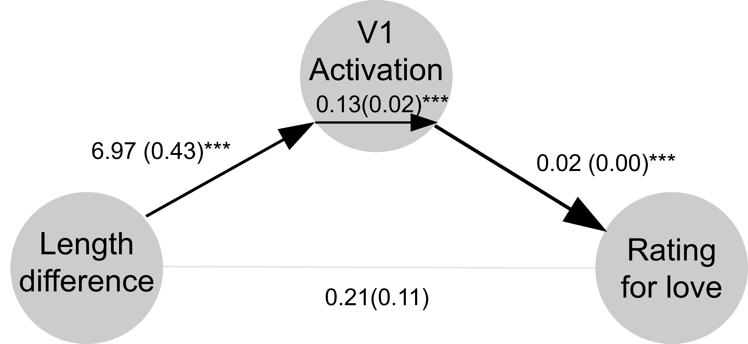
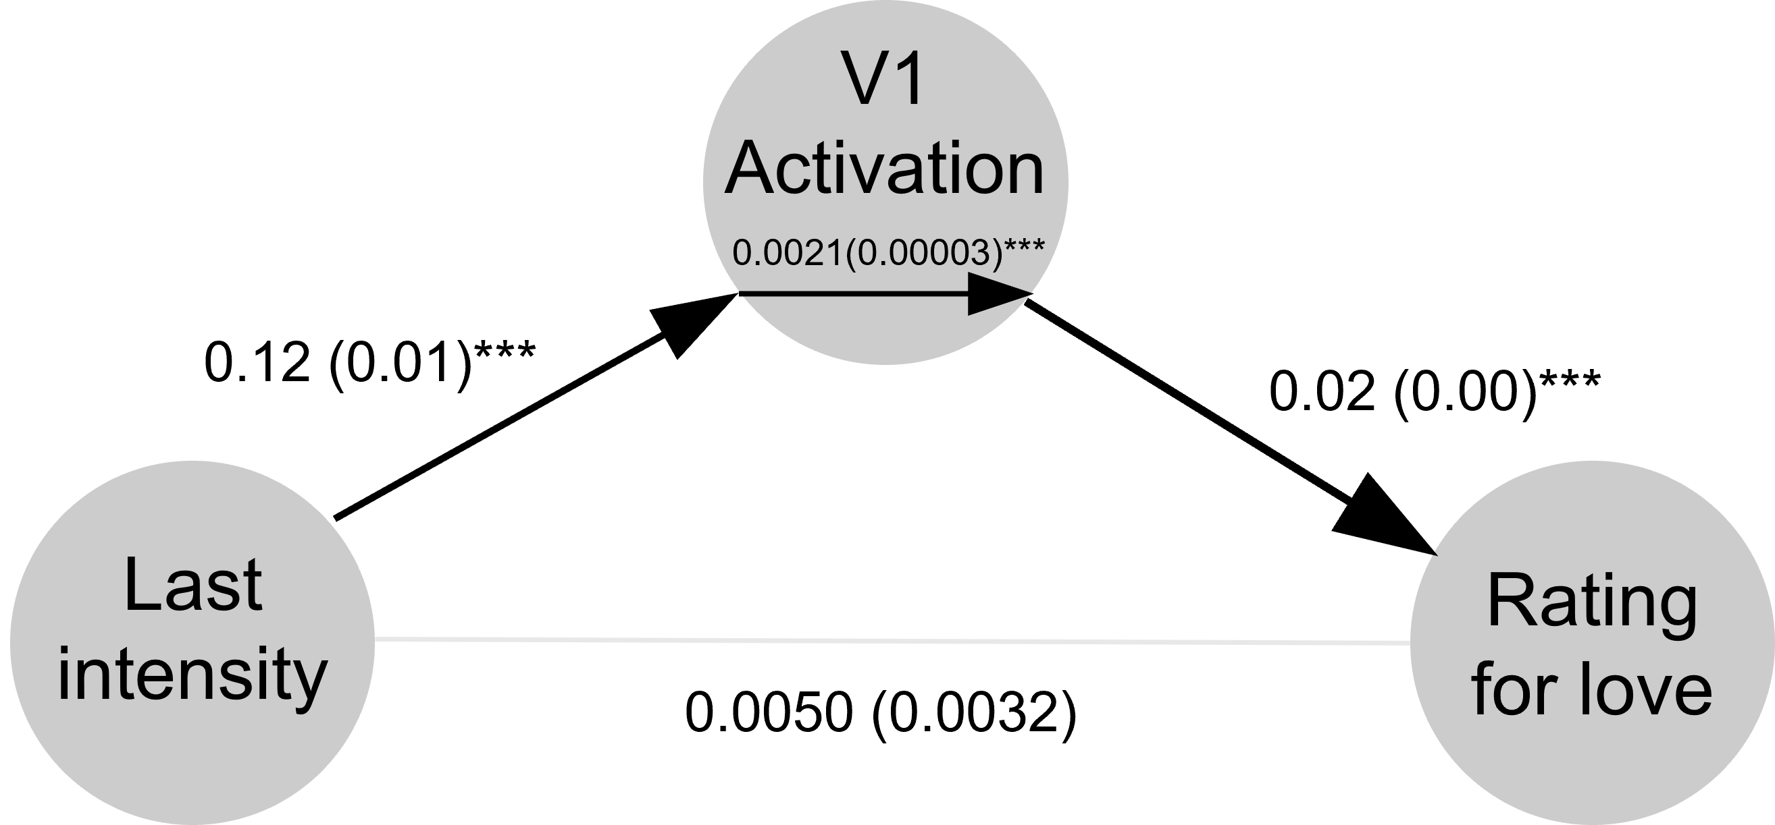
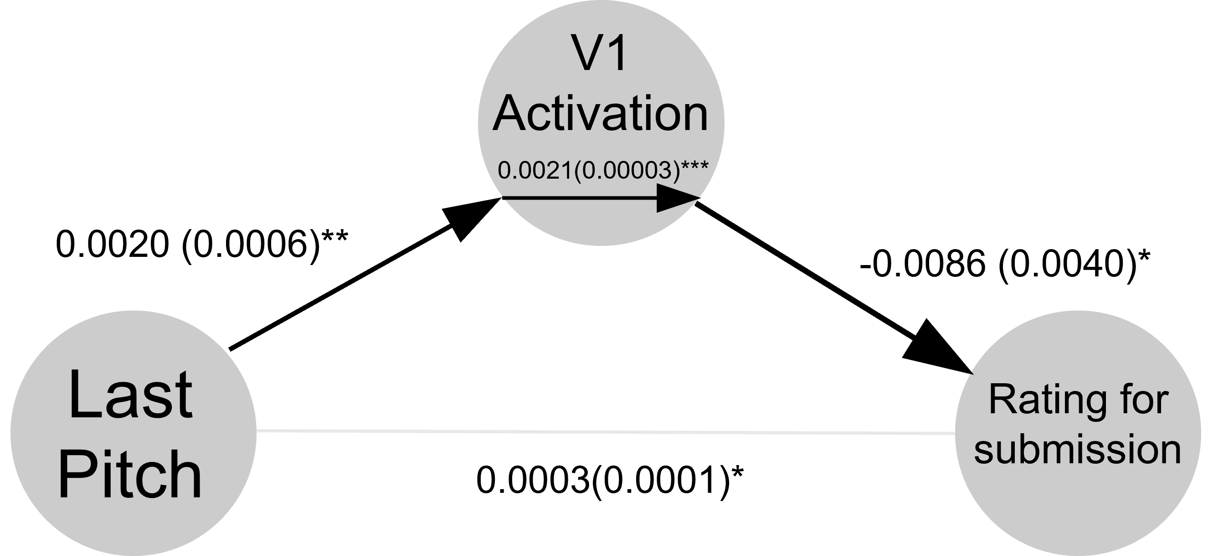

인간 음성의 물리적 특성이 사회적 관계 인식에 미치는 영향
The Effect of Physical Features of Human Voice on Recognition of Social Relationships
서울대학교 심리학과
장준호, 강원준(TA), 이수현(지도교수)
8729wnsgh@snu.ac.kr
INTRODUCTION
RESULTS
Voice efficiently conveys thoughts and meanings. Beyond language, vocal elements such as pronunciation, speed, intonation, and volume help interpret intentions (Ha & Heo, 2018).
Previous research has primarily focused on linguistic aspects, showing how morphemes are automatically processed (Lee & Lee, 2018) and how vocal traits like speed and intensity influence impressions (Kwon, 2015).
However, prior literature on staged voices lacks an exploration of the voice’s role in assessing interpersonal relationships.
While low frequencies are linked to dominance (Hodges-Simeon et al., 2010), it is unclear if such features influence perceived relational dynamics.
Moreover, Lee et al. (2024) reaffirmed that the frequency of the first syllable has a significant inhibitory effect on auditory word recognition, suggesting that syllable characteristics may influence meaning and provide diverse information.
Correlation between Physical Features and Social Recognition
MAIN QUESTIONS
How do physical features of voice influence the recognition of interpersonal relationships?
What role does the final syllable play in interpreting social-cognitive states through voice?
METHODS
Experiment
Instruction
Clip
Delay
Rating
*p < 0.05
LOVE
SUBMISSION
Correlation between Physical Features and BOLD Signals by subjects
Actor
Target
HATE
INDEPENDENCE
ROIs
A1
Total : Total physical feature
Last : Physical feature for last syllable
Mean : Average syllable’s physical feature,
Diff : Difference between Total and Last
Data extraction
Correlation coefficient between length and BOLD signal
V1
Correlation coefficient between pitch and BOLD signal
Intensity
135 lines
(63 clips)
***
Correlation coefficient between intensity and BOLD signal
Pitch
Length
Filtering
Primary Auditory Cortex
***
***
***
***
***
Derived
pitch (Hz)
11 lines
(9 clips)
***
Derived
intensity (dB)
Merging
Physical Features
**
**
54 lines
(54 clips)
**
63 clips (under 23.18 seconds) extracted from the movie ‘Actress (2009)’.
12 acoustic features were measured for each speech,
Frequency (Overall frequency, final syllable frequency, difference and ratio of the two)
Length (Mean syllable length, final syllable length, difference and ratio of the two)
Intensity (Overall intensity excluding final syllables, final syllable intensity, difference and ratio of the two)
Physical feature extraction was conducted using the ‘Praat’.
Participants
30 participants viewed the movie clips in an fMRI scanner and evaluated the relationships between two characters in each clip.
They rated the interactions based on four aspects (Love / Hate / Submission / Independence), commonly suggested in previous studies (Benjamin, 1974; Wiggins, 1979; Birtchnell, 1994; Kiesler, 1997).
The evaluated relationship, brain signal data were collected from the experiment of Kang (TA).
***
Mediation between Physical Features and Social Recognition
Mediating Effect of the Primary Auditory Cortex (A1)
Mediating Effect of the Primary Visual Cortex (V1)
Length difference : Difference between mean and last syllable length / Last intensity : Intensity of last syllable / Last Pitch : Pitch of last syllable
***p < 0.001, *p < 0.05, Bootstrap Test
CONCLUSIONS
REFERENCES
In the last syllable, length and intensity predicted love, and pitch predicted submission. And the difference between mean and last syllable length predicted both opposing concepts of love and hate.
Physical features associated with social recognition showed a larger BOLD signal in the A1 compared to the V1. The degree of A1 activation functioned as a mediator.
Physical features not only convey linguistic meaning but also shape interpersonal impressions and evaluations.
Moreover, this study represents a novel approach by focusing on the physical elements of vocal language, particularly the final syllable.
Future work should explore the mechanisms linking vocal features to recognition, particularly their neural underpinnings, and test these findings in real-world settings.
Benjamin LS (1974) Structural analysis of social behavior. Psychol Rev 81.
Birtchnell J (1994) The Interpersonal Octagon: An Alternative to the Interpersonal Circle. Human Relations 47.
Bo Mi Ha, & Myung Jin Huh (2018). The Effect of Pitch, Duration, and Intensity on a Preception of Speech. Journal of speech-language & hearing disorders, 27(3), 45-54.
Bänziger, T., Patel, S., & Scherer, K. R. (2014). The role of perceived voice and speech characteristics in vocal emotion communication. Journal of Nonverbal Behavior, 38(1), 31-52.
Hodges-Simeon, C. R., Gaulin, S. J., & Puts, D. A. (2010). Different vocal parameters predict perceptions of dominance and attractiveness. Human Nature, 21(4), 406-427.
Kiesler DJ (1997) Contemporary interpersonal theory and research: personality, psychopathology, and psychotherapy. Journal of psychotherapy practice and research 6.
Lunden, A. (2011). The weight of final syllables in English. In Proceedings of the 28th West Coast Conference on Formal Linguistics (pp. 152-159). Somerville, MA: Cascadilla Proceedings Project.
Wiggins JS (1979) A psychological taxonomy of trait-descriptive terms: The interpersonal domain. J Pers Soc Psychol 37.

